Slide 1

Introduction to IOT

Slide 2
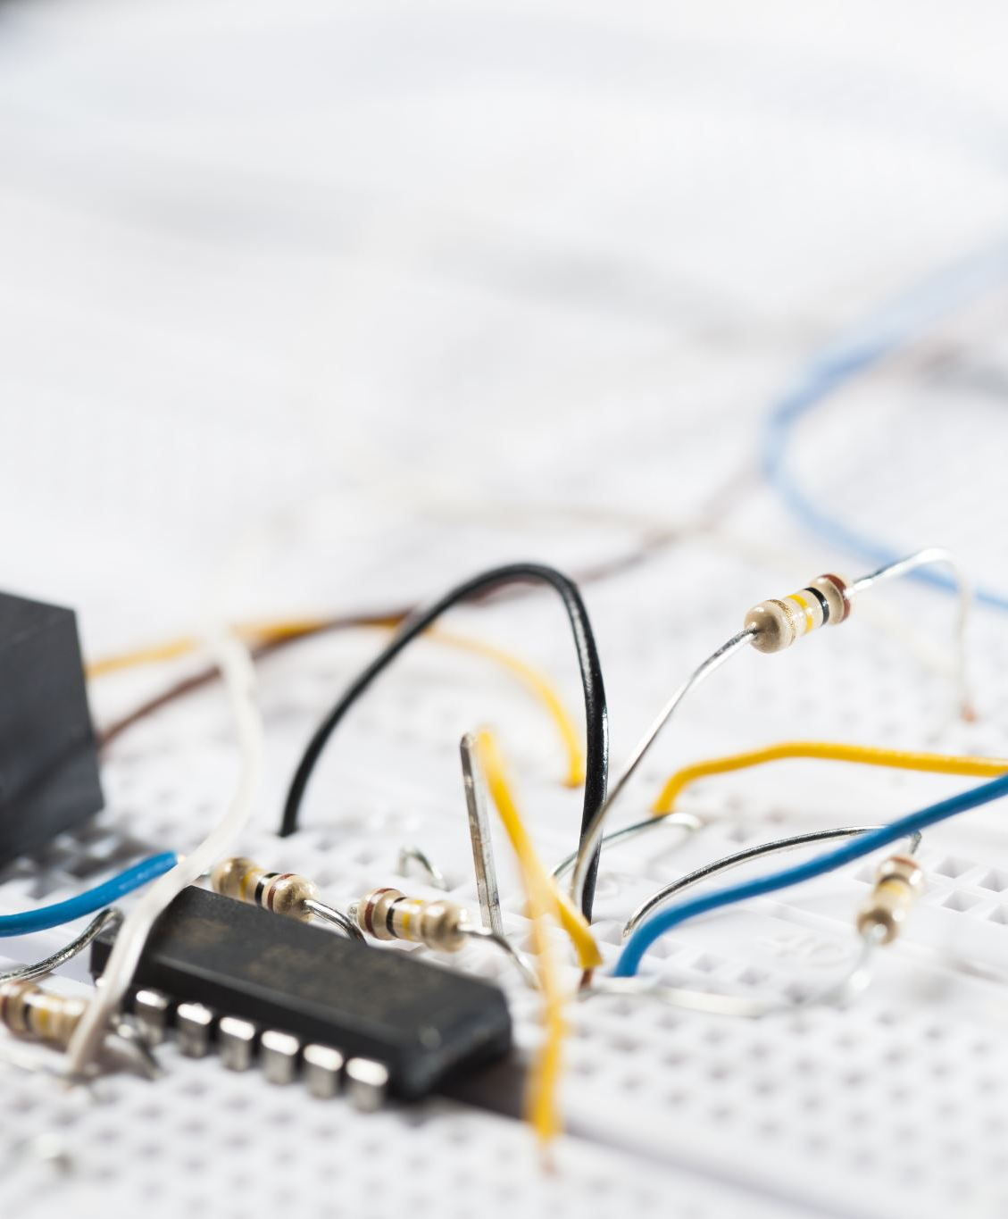
Introduction to IOT
What is IOT
Key components:
Sensors and devices
Connectivity
Data processing
User Interface
Notes:
Definition of IoT:
• The Internet of Things refers to a network of interconnected devices that collect and exchange data.
• These devices can sense and control objects remotely over existing network infrastructure.
Sensors and Devices:
• These are the “things” in IoT that collect data from their environment.
• Examples include temperature sensors, motion detectors, and smart appliances.
Connectivity:
• Devices use various methods like Wi-Fi, Bluetooth, and cellular networks to communicate.
• Connectivity allows data to be transmitted between devices and to the cloud.
Data Processing:
• Collected data is sent to cloud computing systems for processing.
• Data analytics tools interpret this data to provide meaningful insights.
User Interfaces:
• Users interact with IoT devices through applications and dashboards.
• Interfaces allow for monitoring and controlling devices remotely.

Slide 3

Use cases of IOT
Smart homes
Industrial IOT
Healthcare
Smart cities
Agriculture
Notes:
Smart Homes
Industrial IoT (IIoT):
Predictive Maintenance:
Automation:
Supply Chain Management:
Healthcare:
Wearable Devices:
Remote Patient Monitoring:
Smart Medical Equipment:
Smart Cities:
Traffic Management:
Waste Management:
Energy Management:
Agriculture:
Precision Farming
Livestock Monitoring
Climate Monitoring

Slide 4
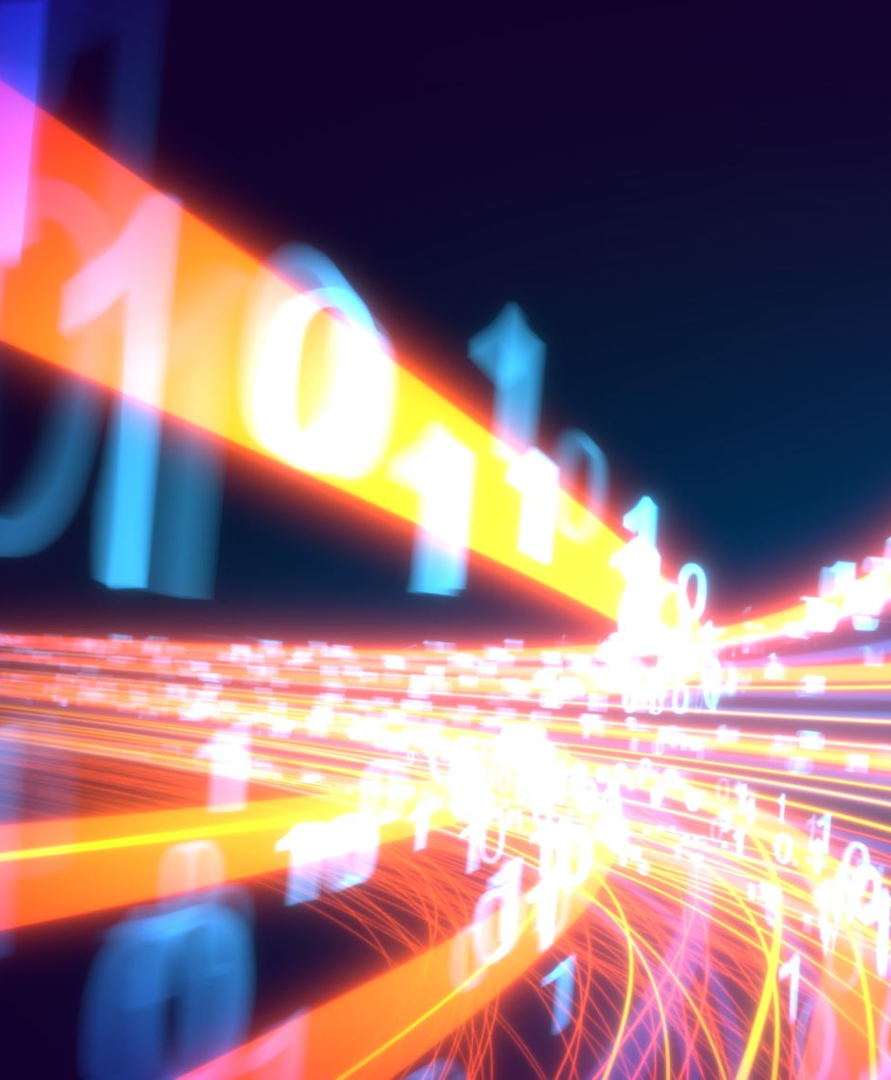
Impact of IOT
Economic Growth
Efficiency and Productivity
QOL Improvements
Environmental Benefits
Notes:
Economic Growth:
• The IoT market is expected to reach trillions of dollars in value.
• Drives innovation and creates new business opportunities.
• Generates employment in technology development and maintenance.
Efficiency and Productivity:
• Automation reduces the need for manual intervention, lowering errors.
• Data analytics from IoT devices inform better business decisions.
• Streamlines operations across various industries.
Quality of Life Improvements:
• Enhances convenience in daily activities through smart devices.
• Improves healthcare outcomes with better monitoring and early detection.
• Supports independent living for the elderly and disabled.
Environmental Benefits:
• Optimizes resource usage, reducing waste and costs.
• Energy-efficient systems decrease the carbon footprint.
• Promotes sustainable practices in industries like agriculture.

Slide 5

Usability and risks
Usability Considerations
Risks:
Security risks
Privacy concerns
Technical issues
Ethical consideration
Notes:
Usability Considerations:
Intuitive User Experience:
• Importance of designing interfaces that are easy to navigate.
• Ensures users can fully utilize device capabilities.
Interoperability:
• Devices should work seamlessly with others, regardless of the manufacturer.
• Adoption of standard protocols and APIs is crucial.
Scalability:
• Systems need to handle an increasing number of devices and data volume.
• Cloud infrastructure can support scalability demands.
Reliability and Maintenance:
• Robust systems minimize downtime and service interruptions.
• Over-the-air updates help keep devices secure and functional.
Security Risks:
• Cyber Attacks:
• Data Breaches:
Privacy Concerns:
• Data Collection:
• Surveillance:
Technical Issues:
• Network Reliability:
• Compatibility Problems:
Ethical Considerations:
• Job Displacement:
• Data Ownership:

Slide 6

Mitigating risks and Future Outlook
Mitigating risks
Future of IOT:
Emerging Technologies
Opportunities
Challenges
Notes:
Mitigating Risks:
• Enhanced Security Measures:
• Privacy Protections:
• Regulatory Compliance:
• Education and Awareness:
Emerging Technologies:
• 5G Networks:
• Artificial Intelligence:
• Edge Computing:
Opportunities:
• Potential for new services and innovative applications.
• Growth in sectors like smart infrastructure and autonomous vehicles.
• Creation of new job roles and industries focused on IoT.
Challenges:
• Managing the complexity of interconnected systems.
• Ensuring global accessibility and bridging the digital divide.
• Addressing ethical concerns and maintaining user trust.

